Slide 1



















New 2022 Indiana Law Home Based Vendors with 2026 updates
Presenter – Jeff Abshear

Slide 2


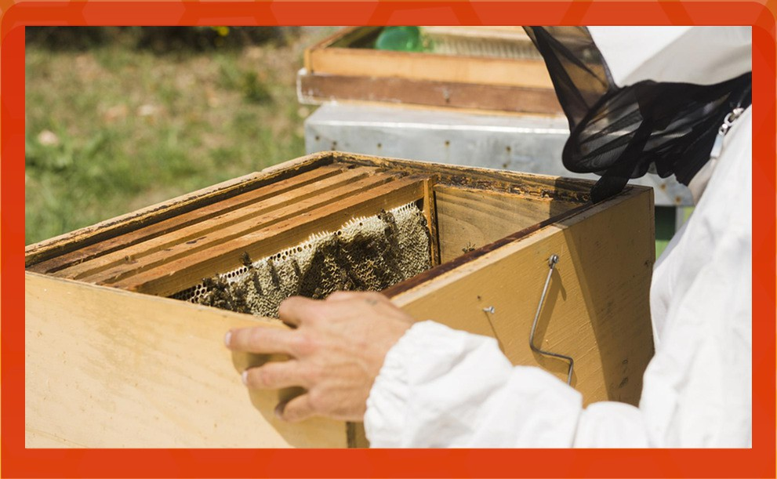


















About Me
Disclaimer: I am not a lawyer. This presentation is for informational purposes only. I hope you can gain knowledge to help Home Based Vendors most of us Beekeepers to comply with the new Indiana law.
Please consult a lawyer for specific
legal advice.

Slide 3










TABLE OF CONTENTS
₀₄
01 New Law
Additional
Information
02 Three Categories of Honey
05 Alternatives
03 Three Major Changes 06 Additional Resources

Slide 4










HOUSE ENROLLED ACT No. 1149
Indiana’s House Enrolled Act 1149 was passed in 2022 and defines the requirements for home based vendors (HBVs) in the preparation and sale of food products. It went into effect on July 1, 2022.

Slide 5
In March 2026 HB1424
In March 2026, Indiana legislators passed House Enrolled Act 1424 which created new rules (IC 16-42-5.4) for products that can be produced and sold to the direct end consumer. This legislation applies to homestead vendors and small farm operators. The Indiana Department of Health (IDOH) has released additional guidance on this regulation.
Pursuant to IC 16-42-5.3, “A home based vendor shall prepare and sell only a food product that is:
made, grown, or raised by an individual at the individual's primary residence, including any permanent structure that is on the same property as the residence
not a Temperature Controlled for Safety (TCS) food product
prepared using proper sanitary procedures
not resold (e.g. you must sell to the end user and not to someone who intends to resell; if you did this you must be licensed as a wholesaler).

Slide 6
HBV’s may sell non-TCS foods
Do Not Require Refridgeration
This list of allowable foods includes:
Baked items such as cookies, cupcakes, cake pops, bread, and muffins
Candy and confections such as chocolates, nougats, caramels, chocolate covered nuts
Tree nuts, legumes
Honey, molasses, maple syrup
Traditional jams, jellies and preserves made from high-acid fruits and using full sugar recipes (This is the only home-canned food allowed.)

Slide 7
HBV’s may Not sell TCS foods
Potentiallly Hazardous FoodsThank
This list of foods that CANNOT be sold by HBV’s includes:
An animal food that is raw or heat-treated
A plant food that is heat-treated
Raw seed sprouts
Cut melon
Cut leafy greens
Garlic-in-oil

Slide 8









Three Types of Honey Producers/Sellers
1
Wholsale Food Est.
Operates under 410 I
AC 7-21 & IC 16-42-5
Retail Food Est.
Operates under 410 I
AC 7-24 & IC 16-42-5
HBV
Vendor
Operates under
IC 16-42-5-29
Home Based Vendor

Slide 9
























Home Based
Vendors
Since many of us extract and bottle our honey out of our homes we fall under
the amended
House Enrolled Act no 1149

Slide 10











3 Major Changes
How and Where Sold
New Food Safety Requirement
Updated Label Requirements
1
2
3

Slide 11
















































How and Where Sold
All sales have to be within the state of
Indiana.
A log has to be maintained for all products shipped or mailed for at least 1 year after the date of sale (electronic or paper).
HBV’s are restricted from selling or delivering
outside of Indiana.
All products must be sold direct to consumer.
They cannot be resold.

Slide 12






































































Food Handler Certificate Requirement
- ServSafe.com
$15 program
- Purdue Extension Office
$40 none on calendar
Alwaysfoodsafe.com
$10 program
StateFoodSafety.com
$10 program

Slide 13




























Slide 14




Food Handler Basics
⬢ Clean—Wash hands and surfaces often.
⬢ Separate—Don't cross-contaminate.
⬢ Cook—Cook to proper temperatures,
checking with a food thermometer.
⬢ Chill—Refrigerate promptly.

Slide 15

Label Requirements
Must Include
⬢ The name and address of the producer
⬢ The common or usual name of the food product
⬢ The ingredients of the food product, in descending order by
predominance by weight
⬢ The net weight and volume of the food product by standard measure
or numerical count
⬢ The date on which the food product was processed
⬢ The following statement in at least 10 point type: "This product is home produced and processed and the production area has not been inspected by Indiana Department of Health. NOT FOR RESALE."

Slide 16




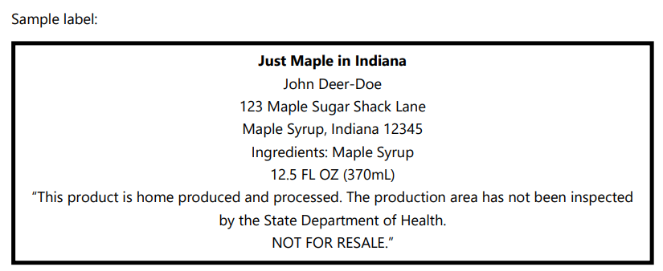
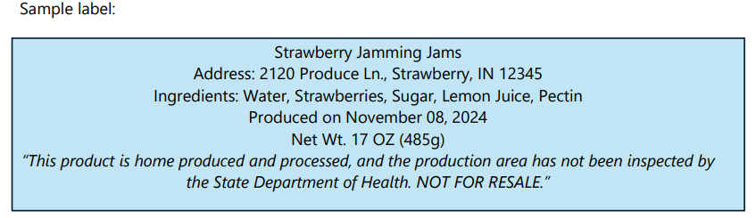
Label Examples

Slide 17





















Additional Points of Info
1. “Roadside stand" can not be located more than one hundred
(100) feet from the edge of the side of the road
Animals must not be present in the food preparation or
packaging area
Home Based Vendor is subject to inspection when either a product has been misbranded, adulterated, or a complaint has been filed with the state department.

Slide 18












































































ALTERNATIVES
Apply and become a Wholesaler
or
Partner with a Retailer and bottle
in a commercial kitchen

Slide 19

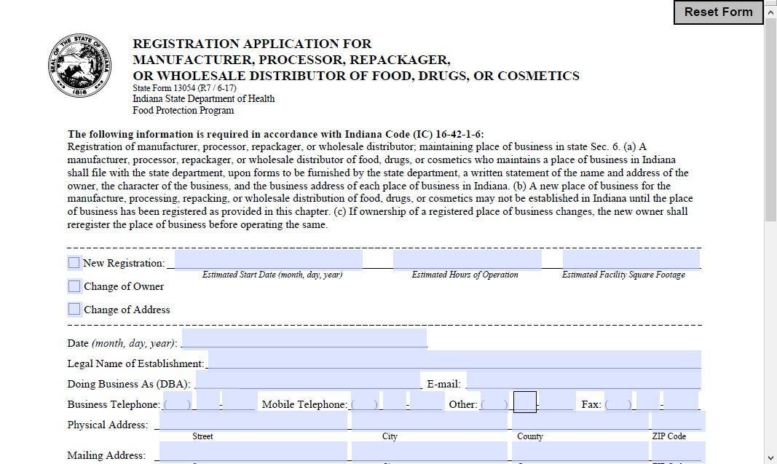










Slide 20










RESOURCES
Links
⬢ Indiana Government House Bill 1149
⬢ https://iga.in.gov/legislative/2026/bills/house/1149/details
⬢ Purdue Agriculture Department
⬢ https://ag.purdue.edu/department/foodsci/home-based-vendors.html
⬢ Wholesale Food Establishment Guidelines
⬢ https://www.in.gov/health/food-protection/wholesale-manufactured-foods-program/starting-a-wholesale-food-business-in-indiana/
⬢ ServSafe Food Handler
⬢ https://www.servsafe.com/ServSafe-Food-Handler
⬢ StateFoodSafety Food Handler
⬢ https://www.statefoodsafety.com/food-handler
Additional Contacts
⬢ Your local health department
⬢ Indiana Dept. of Health | 317-234-8569
⬢ Purdue Food Science Dept. | 764-494-8256

Slide 21

































THANKS!
Do you have any questions?
abshearj1@gmail.com
(765)629-4034
CREDITS: This presentation template was created by Slidesgo, including icons by Flaticon and infographics & images by Freepik
F

Slide 22
HOUSE ENROLLED ACT No. 1149
SECTION 4. IC 16-42-5.3 IS ADDED TO THE INDIANA CODE AS A NEW CHAPTER TO READ AS FOLLOWS [EFFECTIVE JULY 1, 2022]:
Chapter 5.3. Home Based Food Products Sec. 1. (a) As used in this chapter, "end consumer" means a person who is the last person to purchase any food product and who does not resell the food product. (b) As used in this chapter, "roadside stand" means a structure, including a tent, stand, vehicle, or trailer that is: (1) visible from a road; and (2) located not more than one hundred (100) feet from the edge of the side of the road;
Sec. 2. A person may prepare and sell food products as a home based vendor if the person complies with the requirements of this chapter. Sec. 3. The production and sale of food products by a home based vendor in accordance with this chapter are exempt from the requirements of this title that apply to food establishments. Sec. 4. A home based vendor shall prepare and sell only a food product that is:
(1) made, grown, or raised by an individual at the individual's primary residence, including any permanent structure that is on the same property as the residence; (2) not a potentially hazardous food product; (3) prepared using proper sanitary procedures, including: (A) proper hand washing; (B) sanitizing the container or other packaging in which the food product is contained; (C) storing the food product safely;
(D) producing the food product in a food preparation or packaging area in which animals are not present; and (E) cleaning and sanitizing of surfaces that have contact with the food product; (4) not resold; (5) sold in person, by telephone, or through the Internet; and (6) delivered to the end consumer in person, by mail, or by a third party carrier within the state of Indiana.

Slide 23
HOUSE ENROLLED ACT No. 1149
CONTINUED
Sec. 5. (a) A home based vendor shall include a label for packaged food or a sign for unpackaged food that contains the following information: (1)The name and address of the producer of the food product. (2) The common or usual name of the food product. (3) The ingredients of the food product, in descending order by predominance by weight. (4) The net weight or volume of the food product by standard measure or numerical count. (5) The date on which the food product was processed. (6) The following statement in at least 10 point type: "This product is home produced and processed and the production area has not been inspected by the state department of health. NOT FOR RESALE.". (b) A home based vendor shall post the label of each food product on the vendor's Internet web site.
Sec. 6. (a) A home based vendor may not ship or deliver a food product to an end consumer who is located outside Indiana. (b) A home based vendor shall do the following: (1) Ship or deliver a food product in a sealed package that allows an end consumer to determine whether the product has been tampered with.
(2) Maintain a record of the shipping or delivery address of each end consumer the vendor sells a food product to for at least one (1) year after the date of the sale. (3) Upon request, provide a record described in subdivision (2) to the state department.
Sec. 7. (a) A home based vendor shall obtain a food handler certificate from a certificate issuer that is accredited by the American National Standards Institute. (b) Upon request, a home based vendor shall provide a copy of the food handler certificate required by subsection (a) to the state department or an end consumer. (c) A home based vendor shall provide a copy of the food handler certificate required by subsection (a) to the local health department in the county where the home based vendor's residence is located

Slide 24
HOUSE ENROLLED ACT No. 1149
CONTINUED
Sec. 8. (a) A home based vendor is subject to food sampling and inspection if: (1) the state department determines that the home based vendor's food product is: (A) misbranded under IC 16-42-2-3; or (B) adulterated; or (2) a consumer complaint has been received by the state department. (b) If the state department has reason to believe that an imminent health hazard exists with respect to a home based vendor's food product, the state department may order cessation of production and sale of the food product until the state department determines that the hazardous situation has been addressed. (c) For purposes of this chapter, the state health commissioner or the commissioner's authorized representatives may take samples for analysis and conduct examinations and investigations through any officers or employees under the state health commissioner's supervision. Those officers and employees may enter, at reasonable times, the facilities of a home based vendor and inspect any food products in those places and all pertinent equipment, materials, containers, and labeling.

