Slide 1

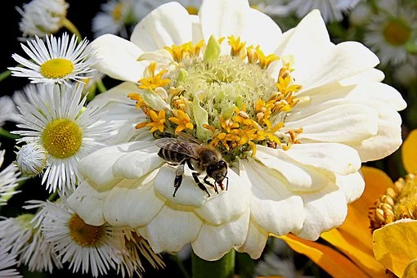
Plants that Support Honeybees
Eileen Van Kavelaar
Notes:
Remarkable creatures – intelligentsia of insect world
Complex system of sharing tasks and communicating
Hygienic – fastidious about grooming themselves and keeping the hive clean.
1st thing bee does after hatching is to clean up debris from the cell it came out of
Hard working
Altruistic in the truest sense – put the colony’s needs over those of their own
If you want to see what true teamwork looks like – look inside a beehive

Slide 2
Numerous Choices
Honeybees differ from bees in general
  Most bees pollinate just one or a few species of plants
  Honeybees pollinate a wide range of plants
    Flowers
    Trees
    Shrubs
    Fruits and Vegetables
    Groundcovers
    Vines
    Weeds
    Even Poison Ivy! (Not toxic to humans and the rash-inducing compound not transferred to honey)
Honeybees need nectar for carbohydrates and pollen for protein
  Some plants provide just one or the other
  Some plants provide both
  Handout will indicate

Slide 3
Right Plant in the Right Place
Light:
  Full Sun = 6 or more hours
  Part Sun = 4-6 hours
  Part Shade = 2-4 hours
Note: These definitions vary
Moisture:
  Some plants need consistent moisture, e.g. Cardinal Flower, Joe Pye Weed
  Some plants do not like “wet feet,” e.g., Lavender, Butterfly Bush, Sedum, Rosemary
Size: How tall and wide will the plant be when it matures? Will it need to be staked?
Spread:
  Plants with aggressive growth rates can take over a garden bed
  Examples: Plants in the Mint family, e.g. Bee Balm, Obedient Plant
  Consider planting in a contained area
Overall Appearance: Neat and tidy vs. on the wild side
Potential Problems: Prone to mildew, diseases, or pests?

Slide 4
Helpful Resources
Missouri Botanical Gardens Website
  www.missouribotanical gardens.org
  Look up plants by common or botanical name
  Shows a picture for most plants
  Brief article includes growing conditions, possible problems
Dave’s Garden Website
  www.davesgarden.com
  Plant Search feature
  Articles Library
  Plant Scout – Where to buy online
  Garden Watchdog – Rates plant catalogs
Gardenia
  www.gardenia.net
Less technical
Photos and Descriptions
Where to buy online

Slide 5
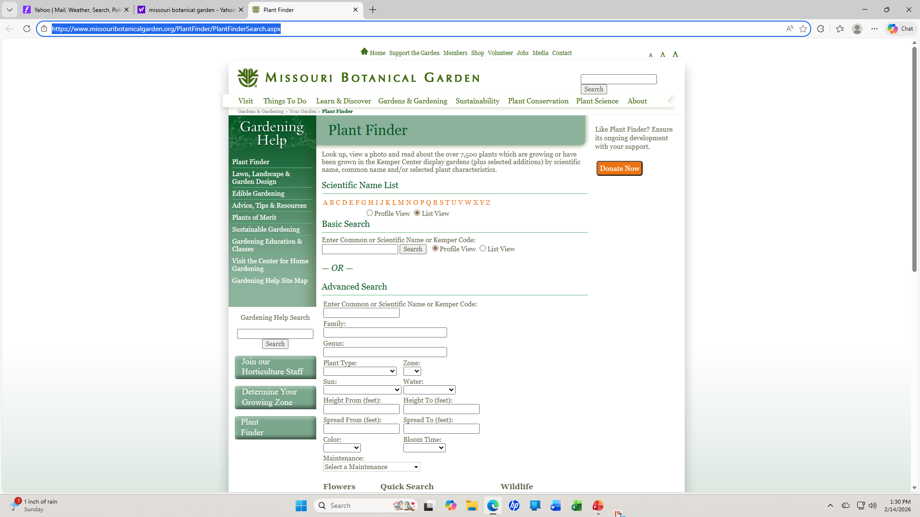

Slide 6
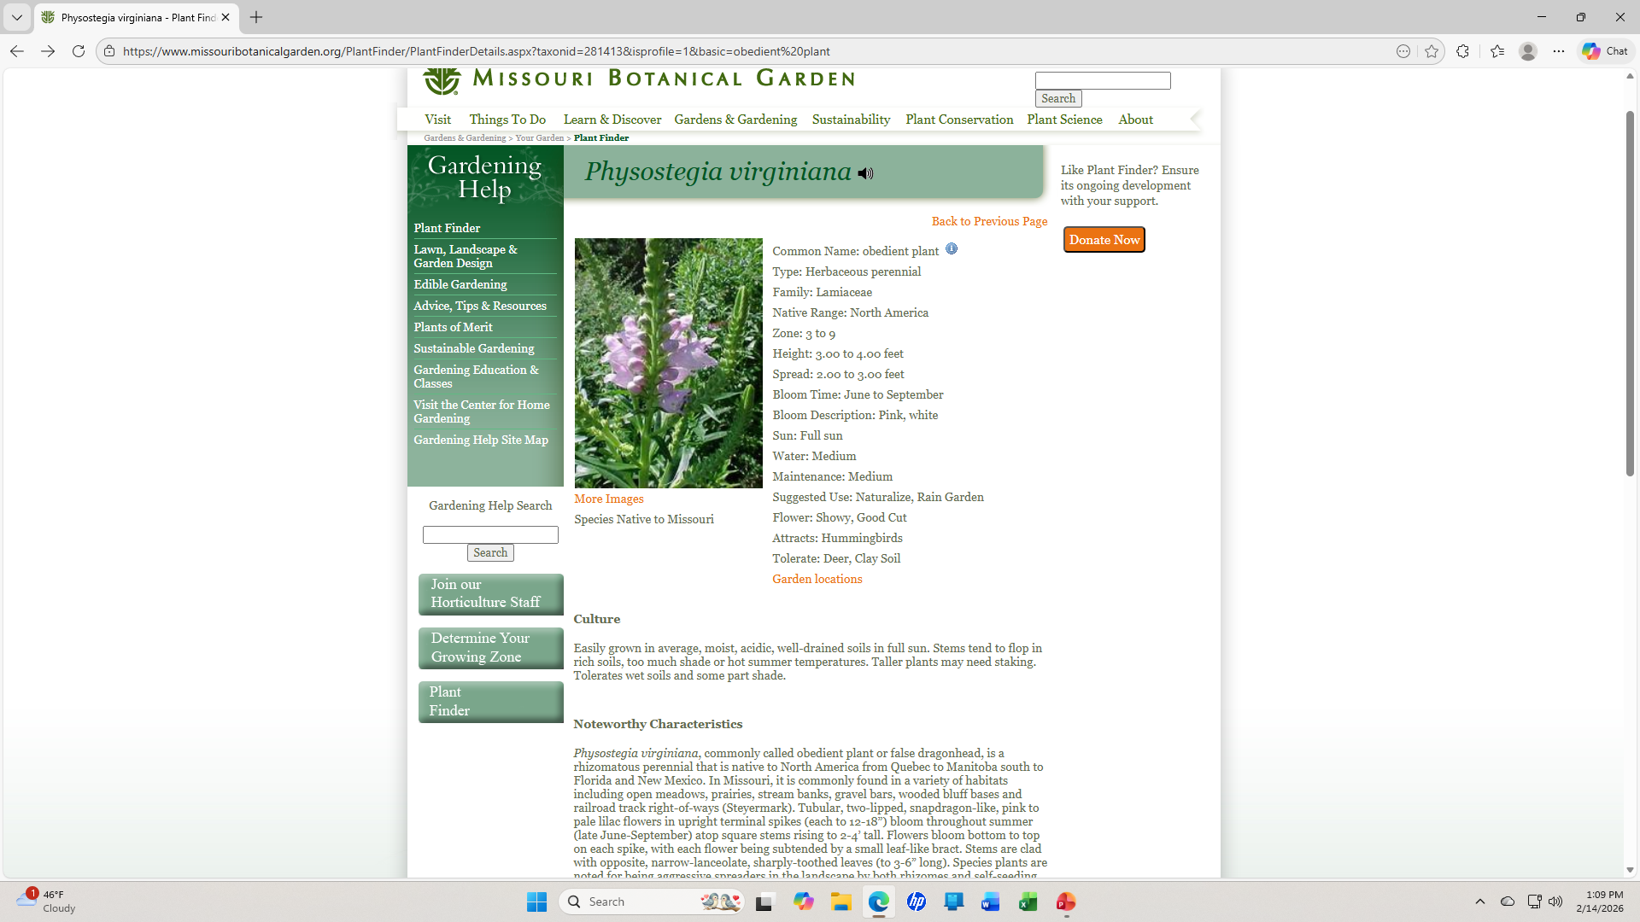

Slide 7
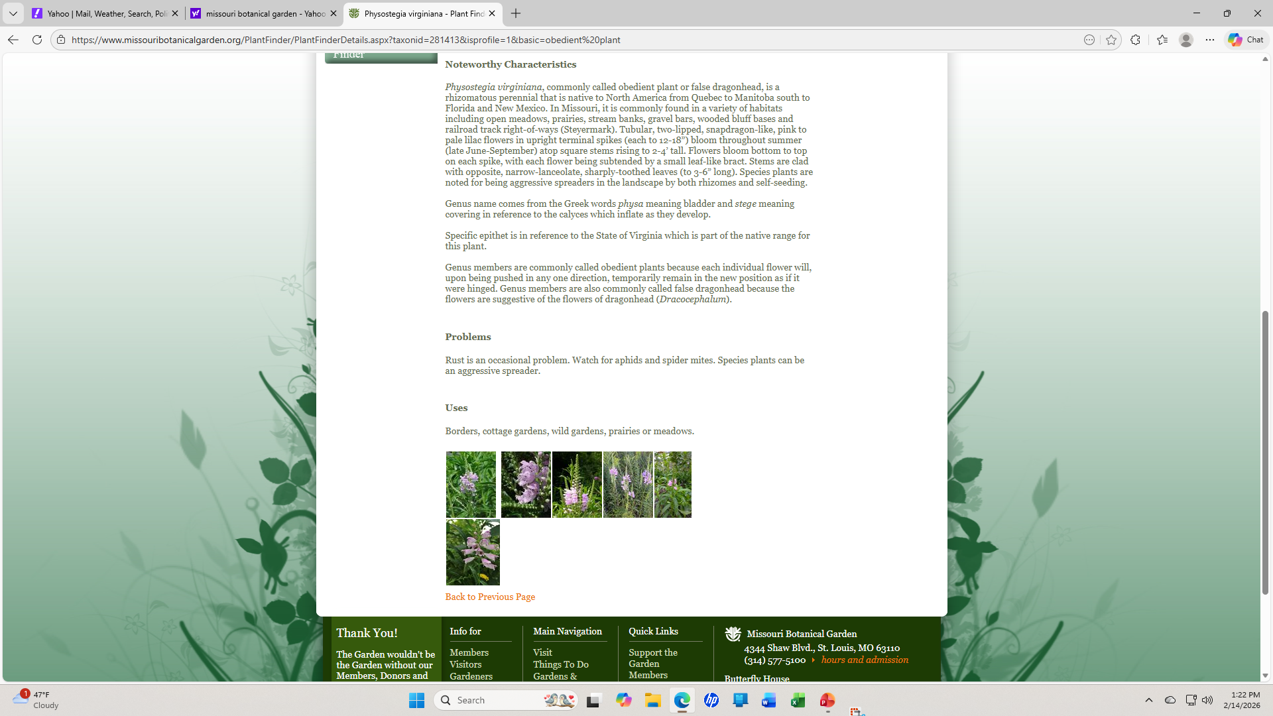

Slide 8
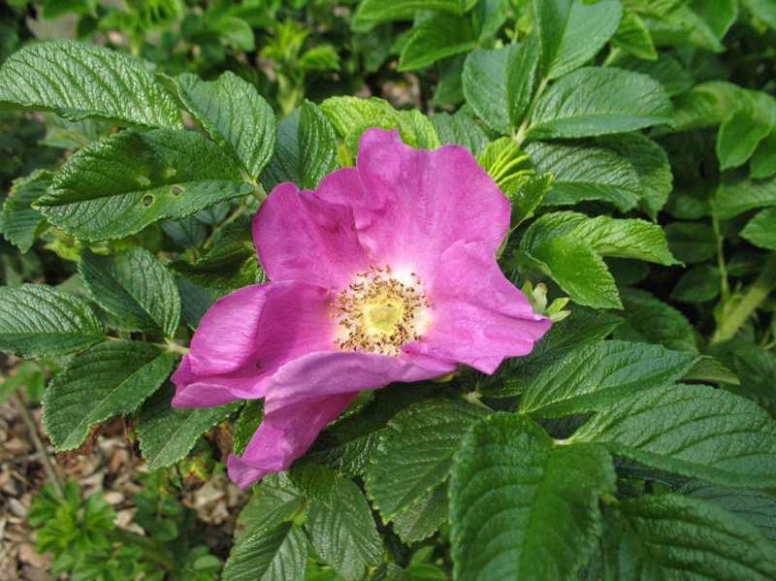
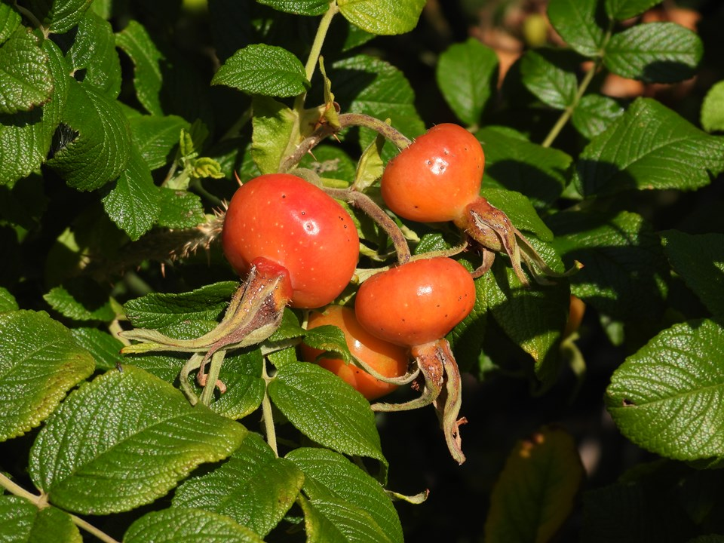
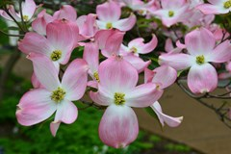
Use Botanical Name to Research and Select Plants
Numerous versions of plants with the same common name
Understanding botanical name ensures you know exactly what you’re getting
Genus: (think general)
Groups together species that are closely related
Latin name that is capitalized and appears in italics
Example: Rosa is genus that groups together over 100 different rose species
Species: (think specific)
Group of naturally occurring plants with shared traits
Can interbreed
Latin name that is not capitalized and appears in italics
Example: Rosa rugosa is species commonly called rugosa rose or tomato rose
Variety:
Different version of a particular species, e.g. flower color, height
Varies as a result of natural evolution
Example: Cornus florida var. rubra (Pink-flowering Dogwood)

Slide 9
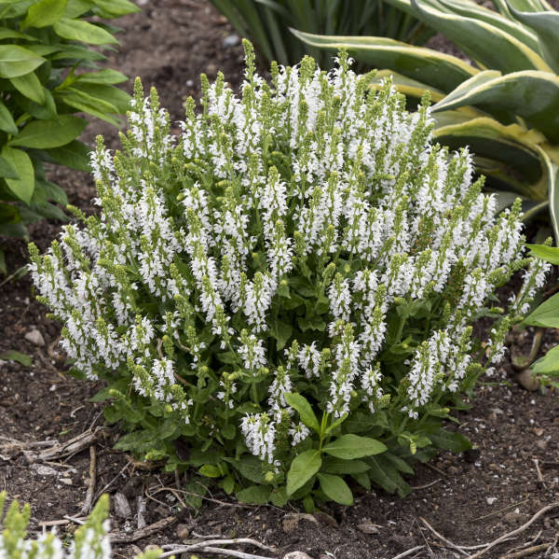
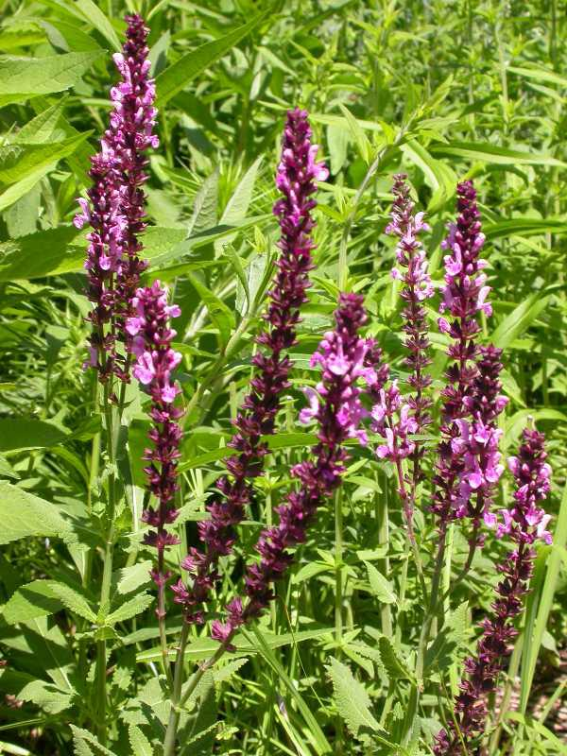
Use Botanical Name to Research and Select Plants
Cultivar: - Short for cultivated variety
Cultivated through human intervention (e.g. stem cuttings, grafting, tissue culture) to create a desirable trait
Retains the trait when propagated
Name appears in single quotes, is capitalized, is not italicized, and is not in Latin
Example: Salvia nemorosa ‘Bumblesnow’
Hybrid:
Plant breeders cross pollinate two different species or varieties to create new traits, e.g. a plant may inherit vibrant color from one parent and a smaller size from another
Seeds of hybrids will not retain the new traits
Will have the letter x in the botanical name
Example: Salvia x Sylvestris (Meadow Sage/Wood Sage)

Slide 10
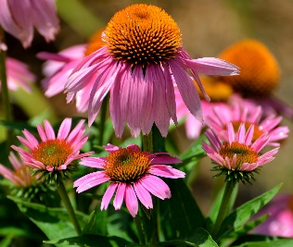
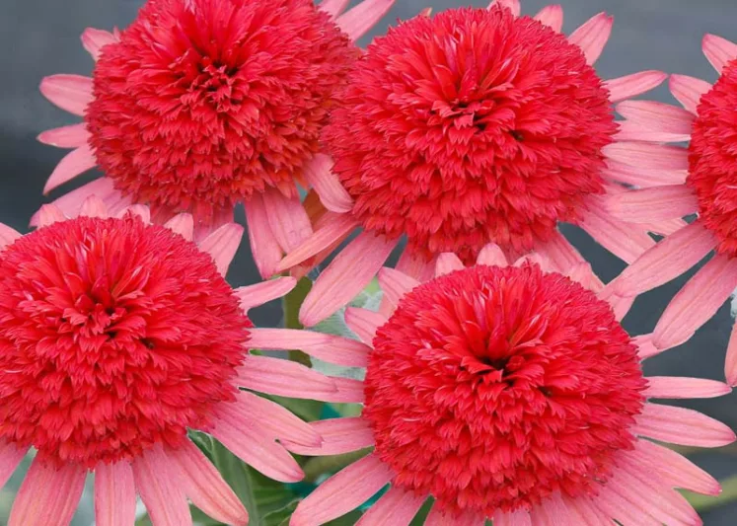
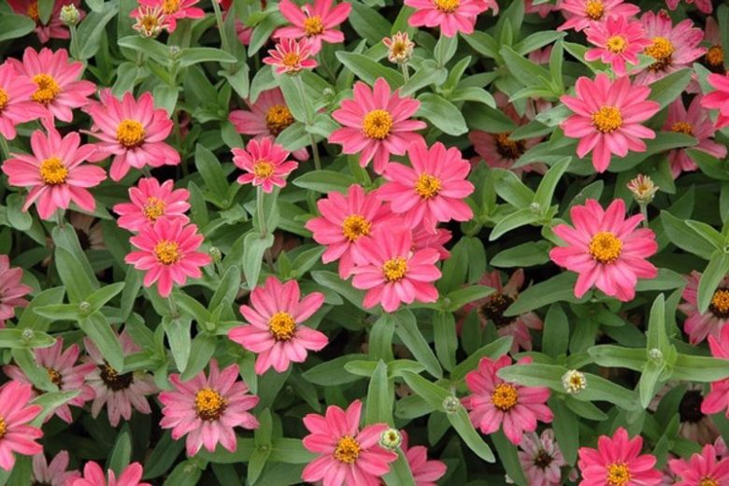
Use Botanical Name to Research and Select Plants
Hybrid (continued):
Often not attractive to honeybees
Double-flowered versions make honey and pollen inaccessible
Color changes can make them less visible to bees
Many offer lower amounts of pollen and nectar
May have a reduced scent
Seeds can be hybrids:
Will be labeled as F1 (first generation)
Example: Profusion Series Zinnia; several marigolds
Cannot be saved from year to year
  Some hybrids produce sterile seeds
  Viable seeds will vary tremendously from the F1
Purple Coneflower Purple Coneflower Hybrid

Slide 11
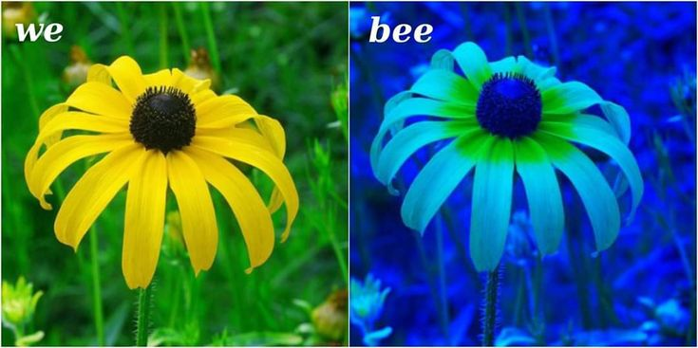
Make Plants Easy to Find
Bees see differently than we do:
Need to be up close to see flowers
Do not easily see shapes
Plant flowers in groups to make them easier to find ( 5 or more plants or area of about 3 feet)
Large plants do not need to be grouped, e.g. New England Aster
Consider flowering shrubs
Flower Colors Easily Detected:
  Blue
  Purple
  Yellow
  White
  Can see ultraviolet light
  UV light shows a pattern which bees use as a landing pad
  Yellow and white flowers create high contrast UV light
  Bees cannot see Red
  Scent:
  Bees will detect fragrant plants
  Culinary herbs, e.g. basil, oregano, and rosemary are popular
  Sweet smelling plants e.g. as lavender, lilac, and fruit trees
  Plants with a distinct odor such as catmint, sage, and chives (ornamental onion)

Slide 12
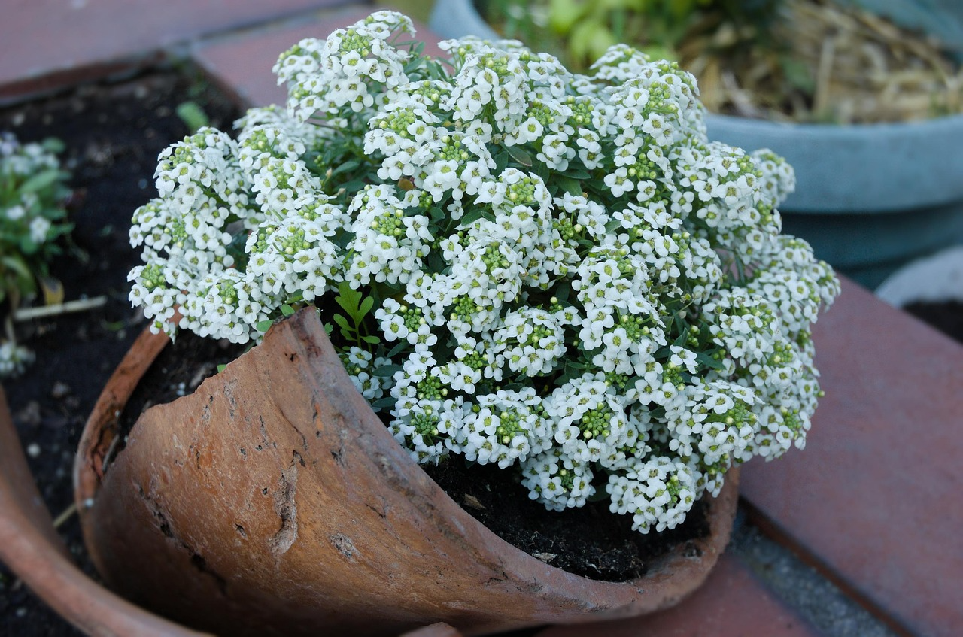
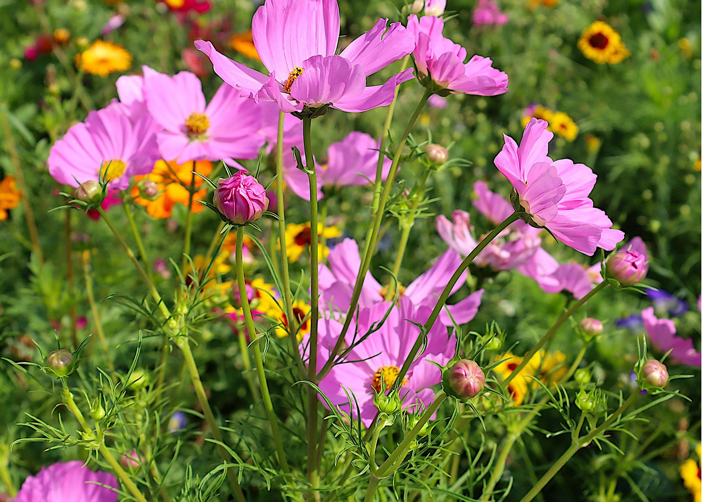
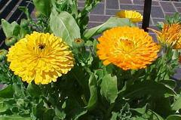
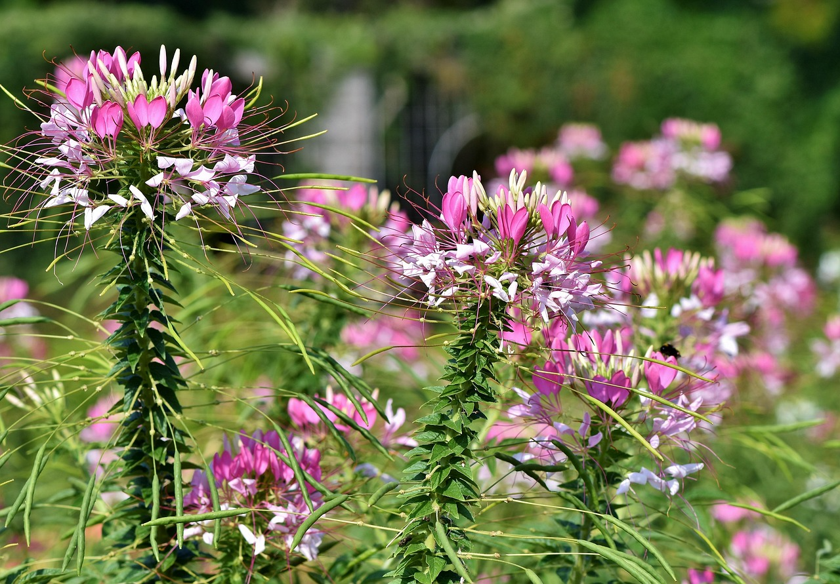
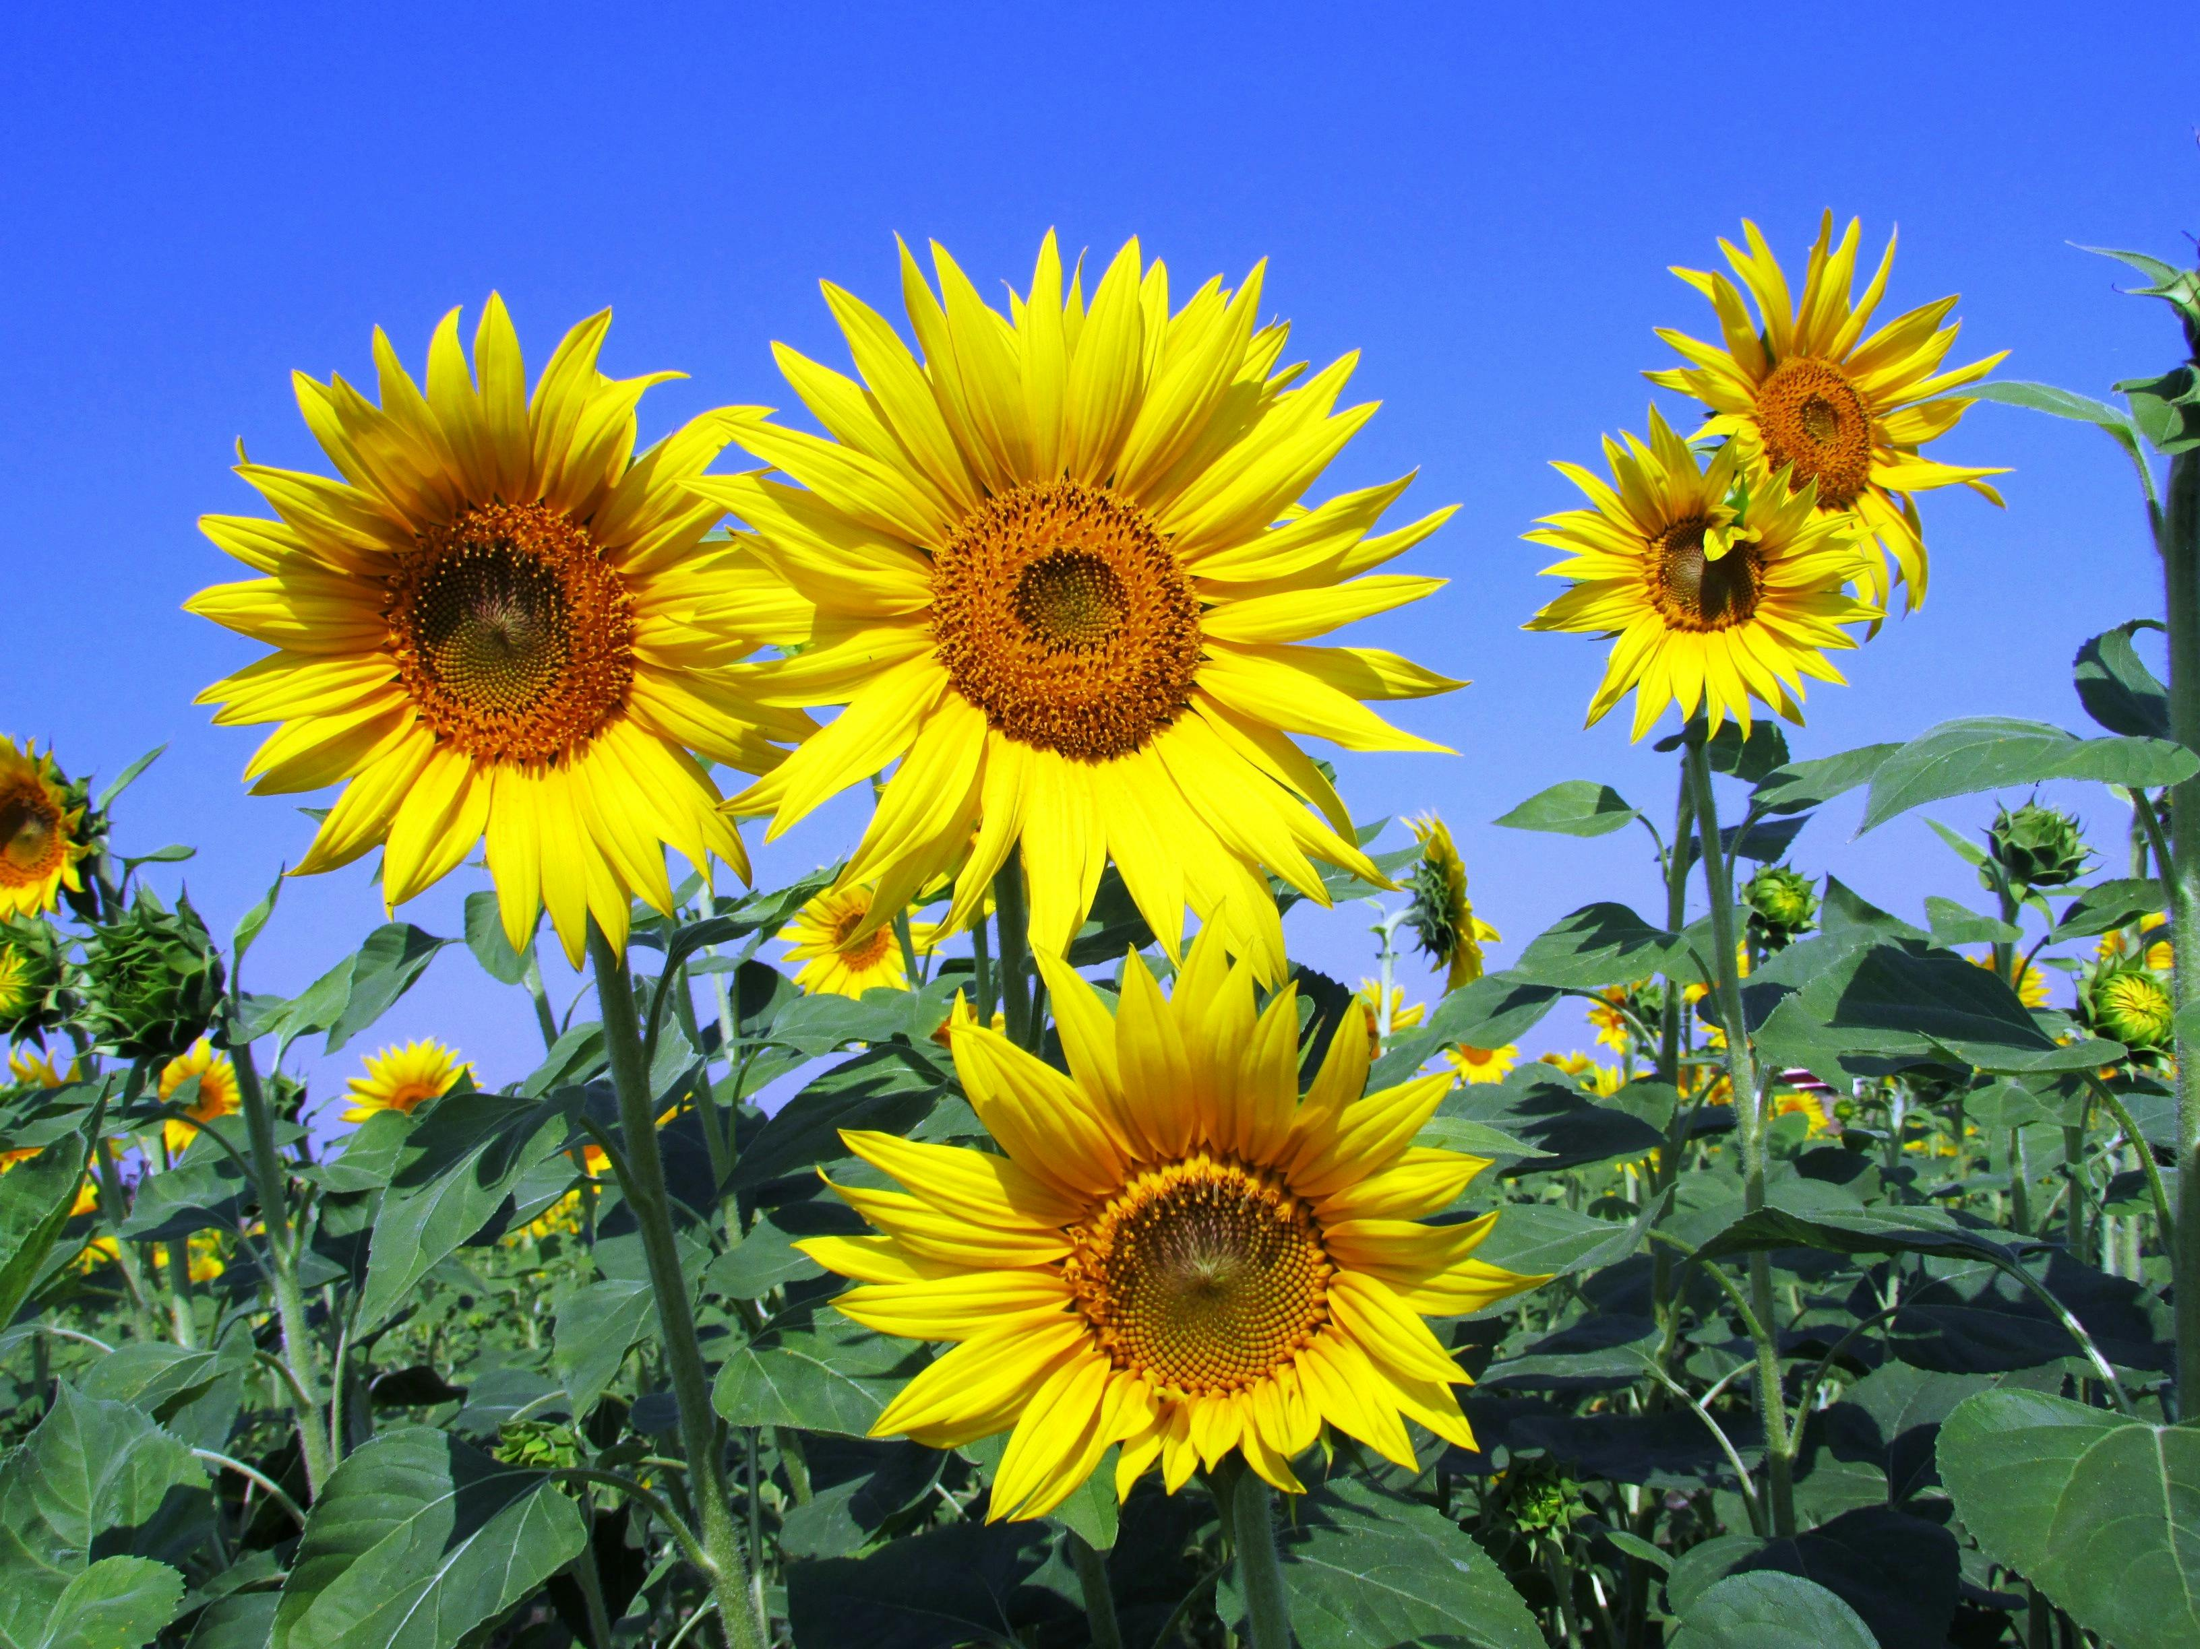
Annuals
Have a one-year life cycle
Annual flowers bloom the entire season
Self-Sowing annuals return due to abundance of seeds produced (Avoid hybrids if you want plants to self-sow)
  Examples:
    Alyssum
    Cosmos
    Pot Marigold
    Spider Flower
    Sunflowers
  Will not return in the exact same spot
  Be able to identify new seedlings in the spring
    May want to take pictures
Basil, borage, and parsley are annuals
Most vegetables are annuals (not asparagus)
Most weeds are annuals

Slide 13
Perennials
Plants that live 3 years or longer
Go dormant in winter and return in the spring
Original plant will return in same spot it was planted
Must be within our hardiness zone (6a) to survive the winter
  Geographical area with an average lowest winter temperature
  Indianapolis was changed from Zone 5b (-10 to -15 degrees Fahrenheit) to
  Zone 6a (-10 to -5 degrees Fahrenheit) in 2023
  Some gardeners still buy Zone 5 plants to be on the safe side
Come into bloom at different times; most bloom during the summer
Period of bloom varies; most are not in bloom all season
Some perennials spread quickly either via self-seeding or fast growing root systems, e.g., Bee Balm, Black-Eyed Susan, Catmint
Some perennials grow quickly and will need to be divided, e.g., Ironweed, New England Aster, and Tall Sedum
  Too big
  “Bald” center
  Smaller blooms

Slide 14
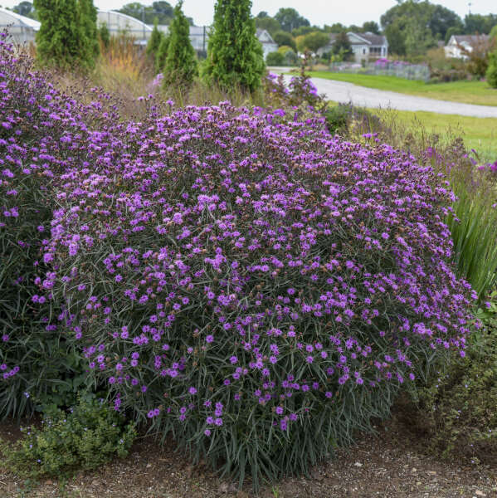
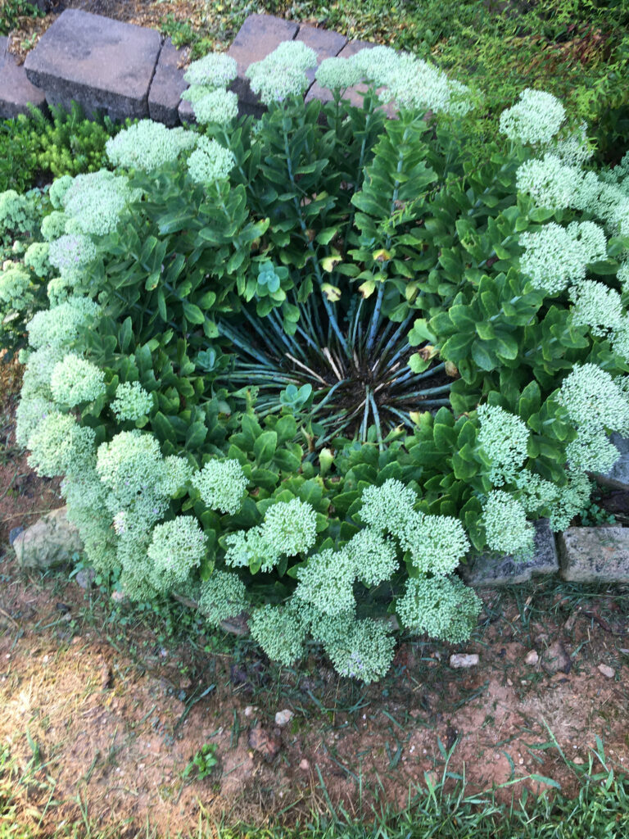
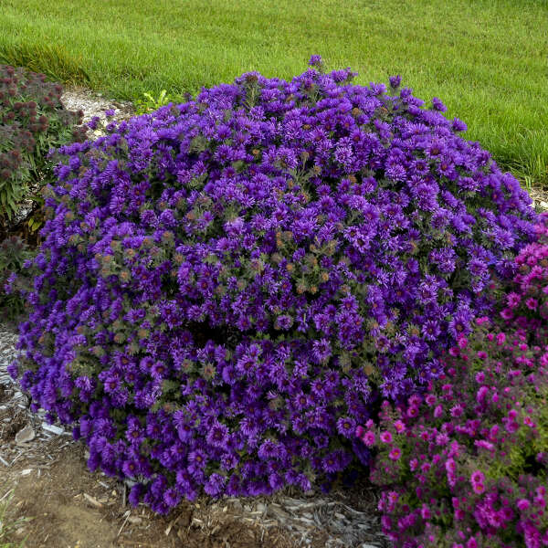
Ironweed, Tall Sedum, and New England Aster

Slide 15
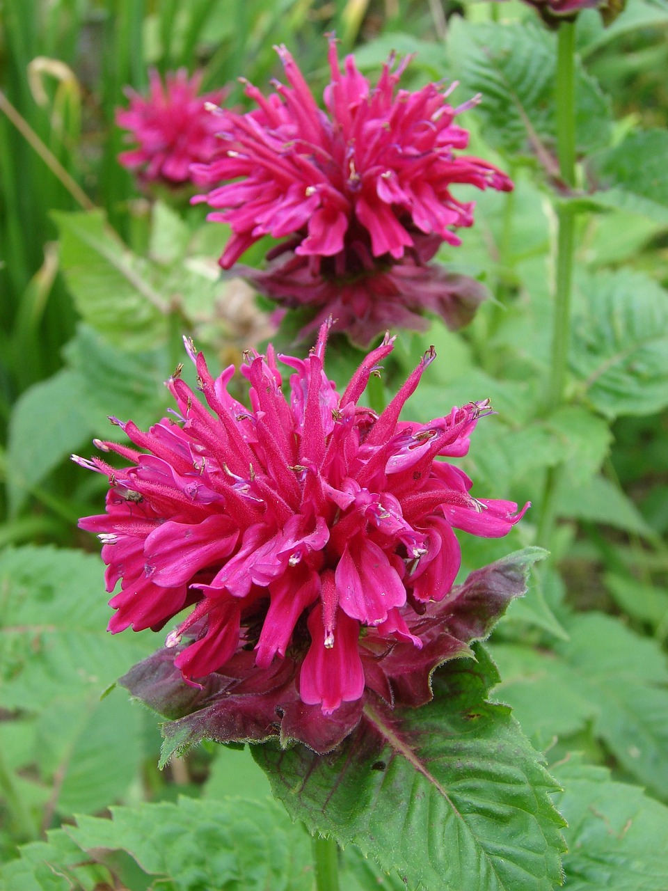
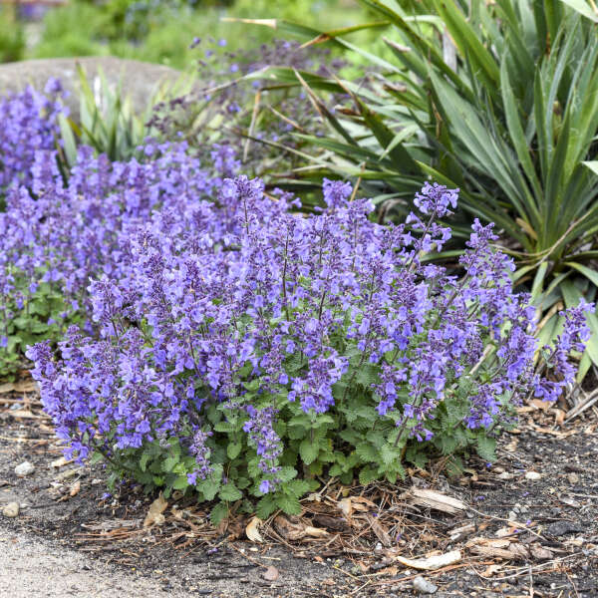
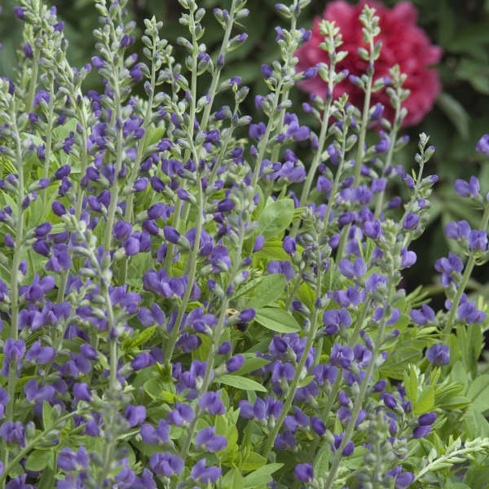
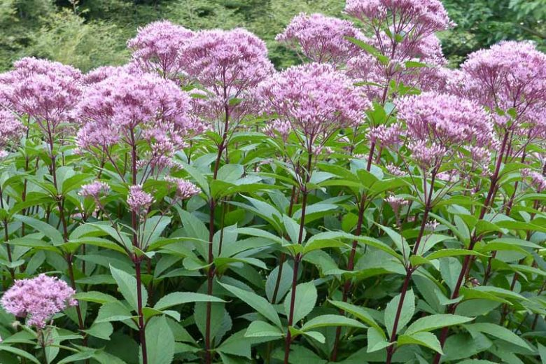
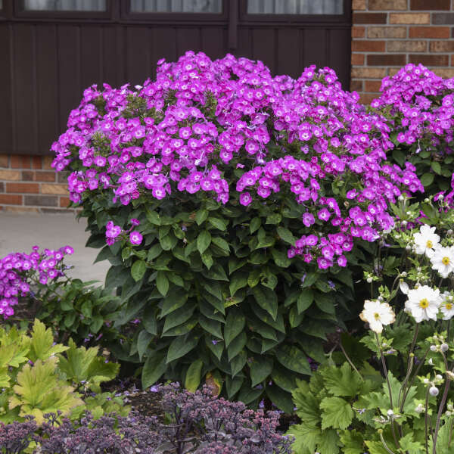
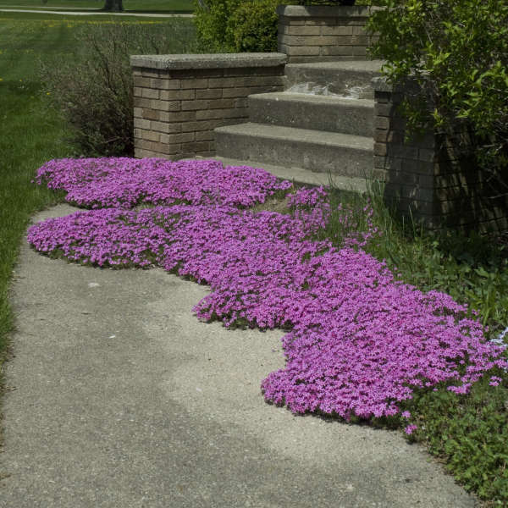
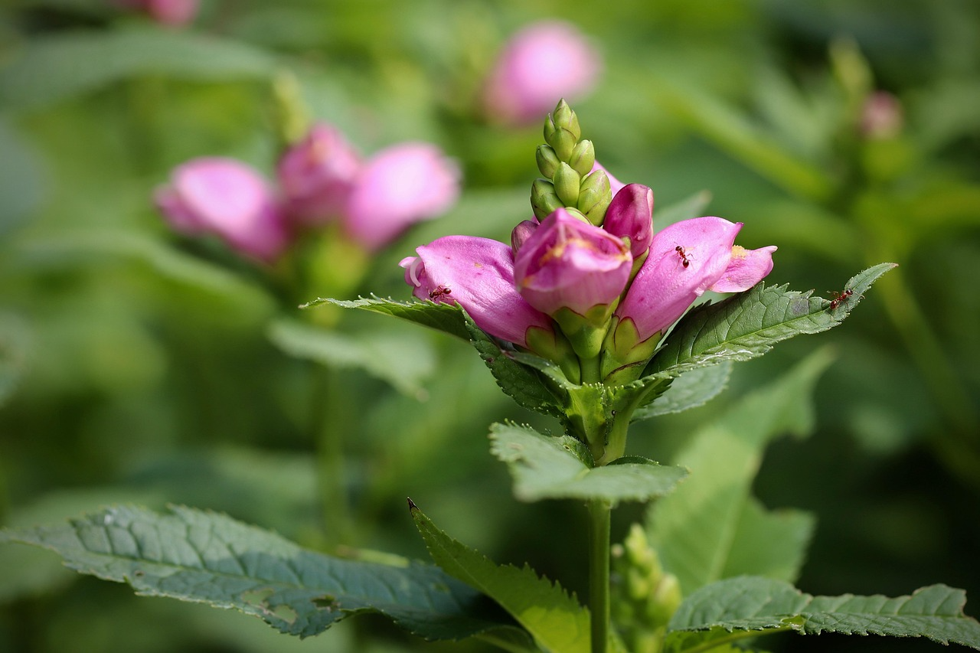
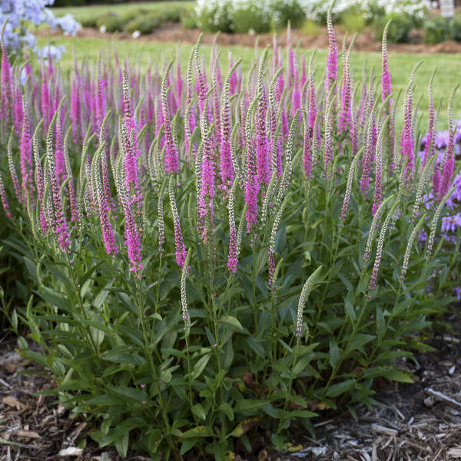
Sample Perennials Growing in Part Sun or Part Shade
Top: Bee Balm, Catmint, False Indigo, Joy Pye Weed
Bottom: Tall Garden Phlox, Creeping Phlox, Turtlehead, Veronica/Speedwell

Slide 16
Online Ordering
Check the size of the pot
  Most are only around 3 inches
  Newgardenplants.com sells “generous quart” size plants
  Romencegardens.com sells quart size pots
Check Ebay and Etsy for better deals
Check the location of the seller
  Closer to Indiana will have lower shipping costs
  Too far away can compromise the plant if shipping takes several days
Check to be sure plant is hardy to Zone 6a

Slide 17
Native Plants
Have existed in a geographical area for thousands of years
Do not need fertilizer
Are drought resistant
Are usually not bothered by pests or disease
Improve soil health
Offer superior nectar and pollen compared to many non-native species
Limited selections in big box stores
Some garden stores have native plant sections
Farrell Family Nursery, 8627 E. McGregor, Indianapolis
  Carries natives at reasonable price
  Contact them to order something they don’t carry
  Residential business open on select weekends spring-fall
  https://farrellnusery.com
Online stores specializing in natives, e.g. Prairie Moon Nursery
  Be sure plants are native to Indiana
  Plants will be more expensive and smaller than if buying in a store

Slide 18
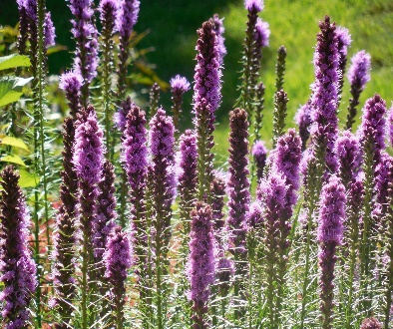
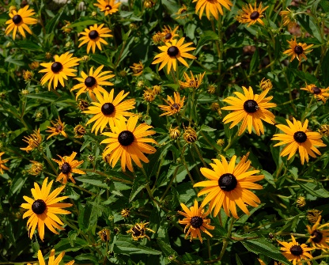
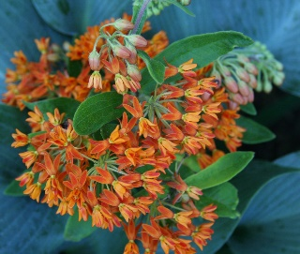
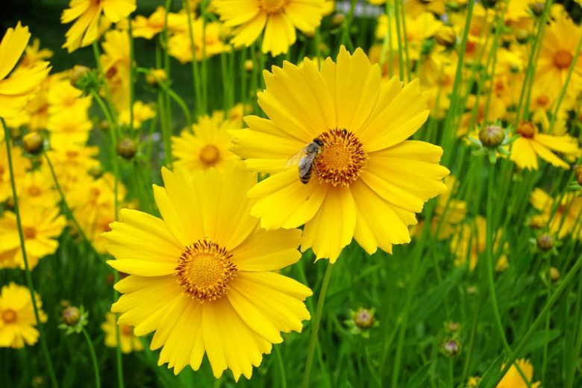
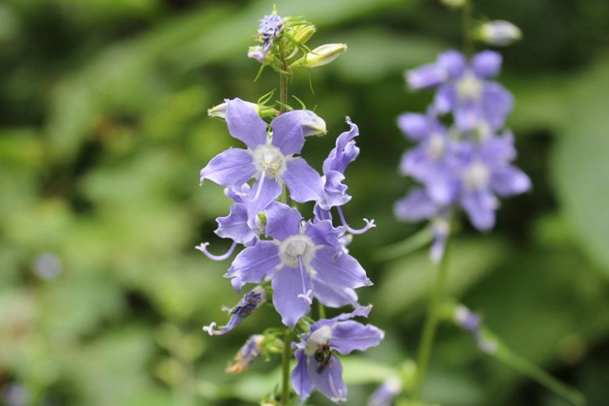
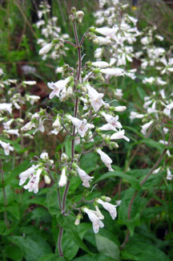
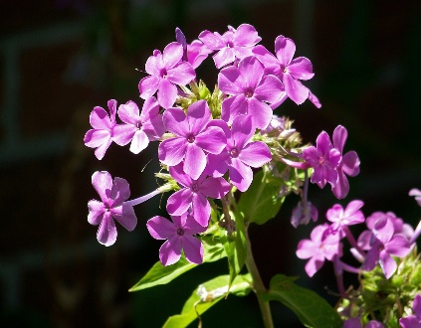
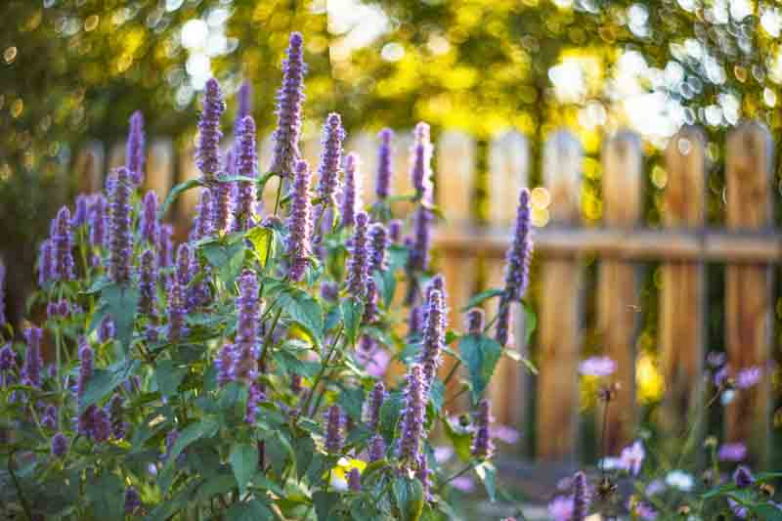
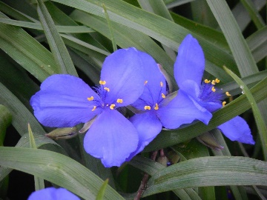
Sample Native Plants for Sun:
Blazing Star Black-Eyed Susan Butterfly Weed Purple Coneflower Lanceleaf Coreopsis
Sample Native Plants for Part-Sun or Part-Shade
American Bellflower Beardtongue Garden Phlox Giant Hyssop Spiderwort

Slide 19
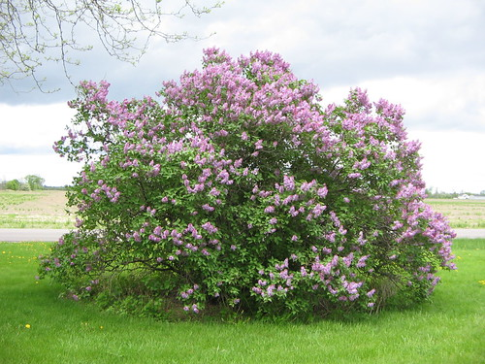
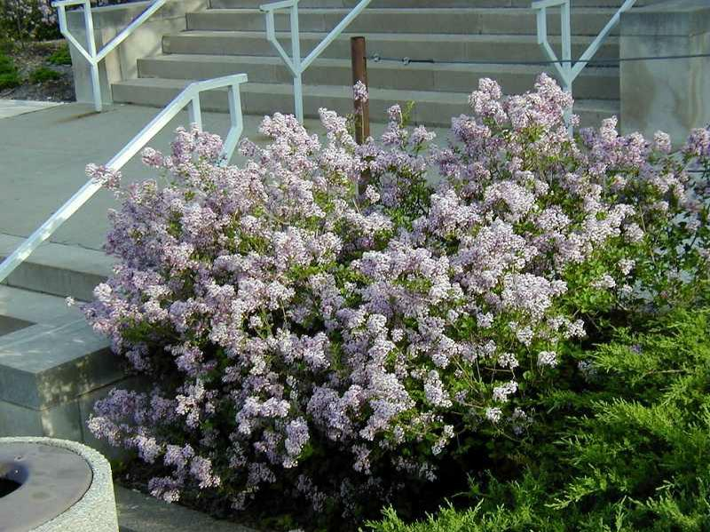
Shrub Cultivars
Common Lilac (Syringa vulgaris) Syringa meyeri ‘Palibin’
10-15 feet tall and wide 4-5 feet tall and 4-6 feet wide
Notes:
Hive shown in upper left has been deserted but shows how the hive is structured about 8 to 10 combs. Oval shaped.
Common for bees in the wild to move into a tree hollow
Honey comb is made of beeswax. Individual cells are hexagon shaped. Cells fit together in a space-saving design.
White substance in cells on lower picture on left side is developing larvae. Eggs develop into larvae, then pupate
A beekeeping hive consists of boxes, each containing 8-10 frames of bees.
Langstroth Hive – Rev. Lorenzo Langstroth 1851
Removable frames revolutionized beekeeping
Bee Space (3/8 inch) keeps bees from cementing the frames together with propolis
Skeps

Slide 20
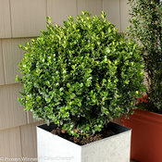
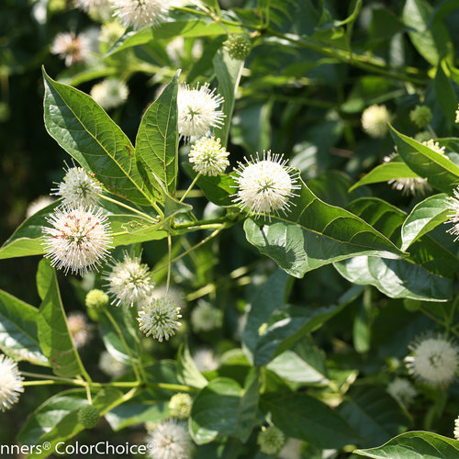
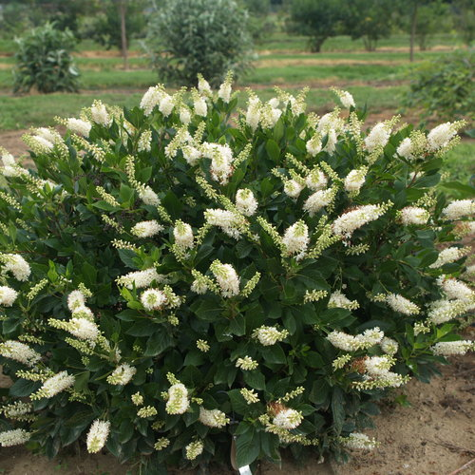
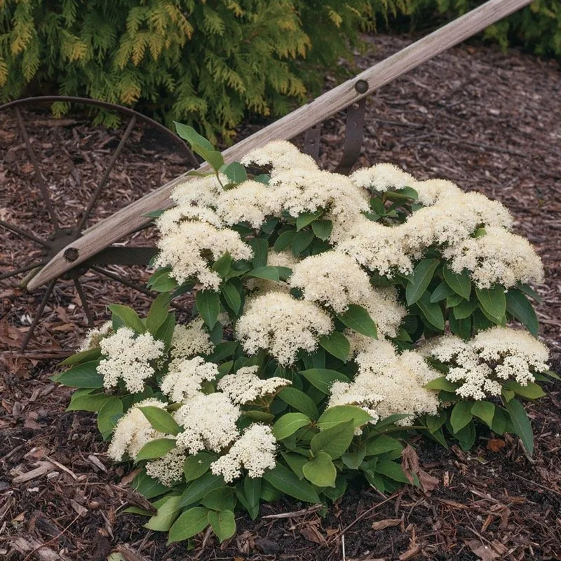
Proven Winners® Dwarf Shrub Cultivars
Sprinter® Boxwood Sugar Shack® Button Bush Sugartina® ‘Cystalina’ Summersweet Lil’Ditty® Witherod Viburnum
2-4 feet tall and wide 4-5 feet tall and wide 30-36 inches tall; 28-36 inches wide 1-2 feet tall and wide
Notes:
Hive shown in upper left has been deserted but shows how the hive is structured about 8 to 10 combs. Oval shaped.
Common for bees in the wild to move into a tree hollow
Honey comb is made of beeswax. Individual cells are hexagon shaped. Cells fit together in a space-saving design.
White substance in cells on lower picture on left side is developing larvae. Eggs develop into larvae, then pupate
A beekeeping hive consists of boxes, each containing 8-10 frames of bees.
Langstroth Hive – Rev. Lorenzo Langstroth 1851
Removable frames revolutionized beekeeping
Bee Space (3/8 inch) keeps bees from cementing the frames together with propolis
Skeps

Slide 21
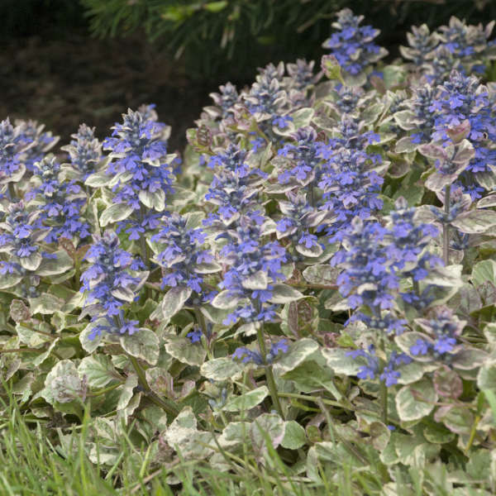
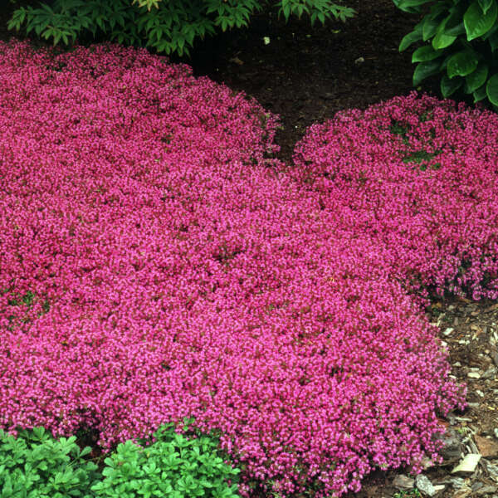
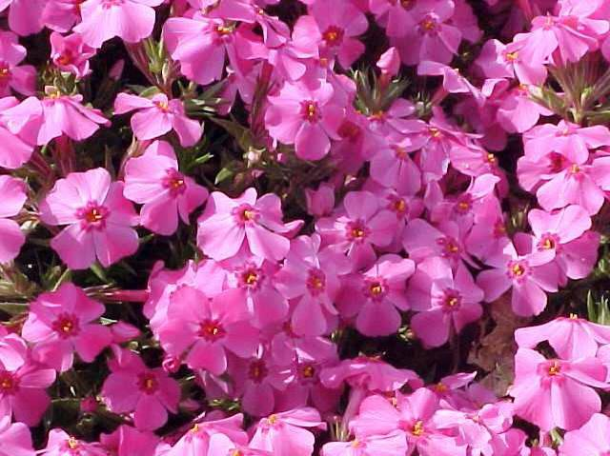
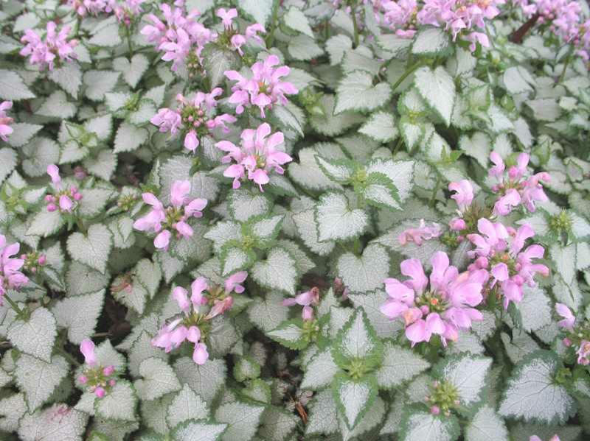
Flowering Ground Cover Cultivars
Ajuga ‘Burgandy Glow’ Creeping Red Thyme ‘Coccineus’ Creeping Phlox ‘Millstream Dahpne’ Dead Nettle ‘Pink Chablis’
Ajuga (aka Bugleweed), Phlox, and Dead Nettle will grow in part shade
Notes:
Hive shown in upper left has been deserted but shows how the hive is structured about 8 to 10 combs. Oval shaped.
Common for bees in the wild to move into a tree hollow
Honey comb is made of beeswax. Individual cells are hexagon shaped. Cells fit together in a space-saving design.
White substance in cells on lower picture on left side is developing larvae. Eggs develop into larvae, then pupate
A beekeeping hive consists of boxes, each containing 8-10 frames of bees.
Langstroth Hive – Rev. Lorenzo Langstroth 1851
Removable frames revolutionized beekeeping
Bee Space (3/8 inch) keeps bees from cementing the frames together with propolis
Skeps

Slide 22
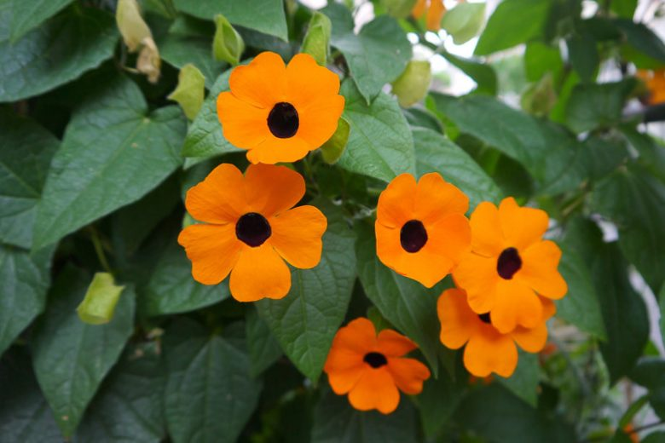
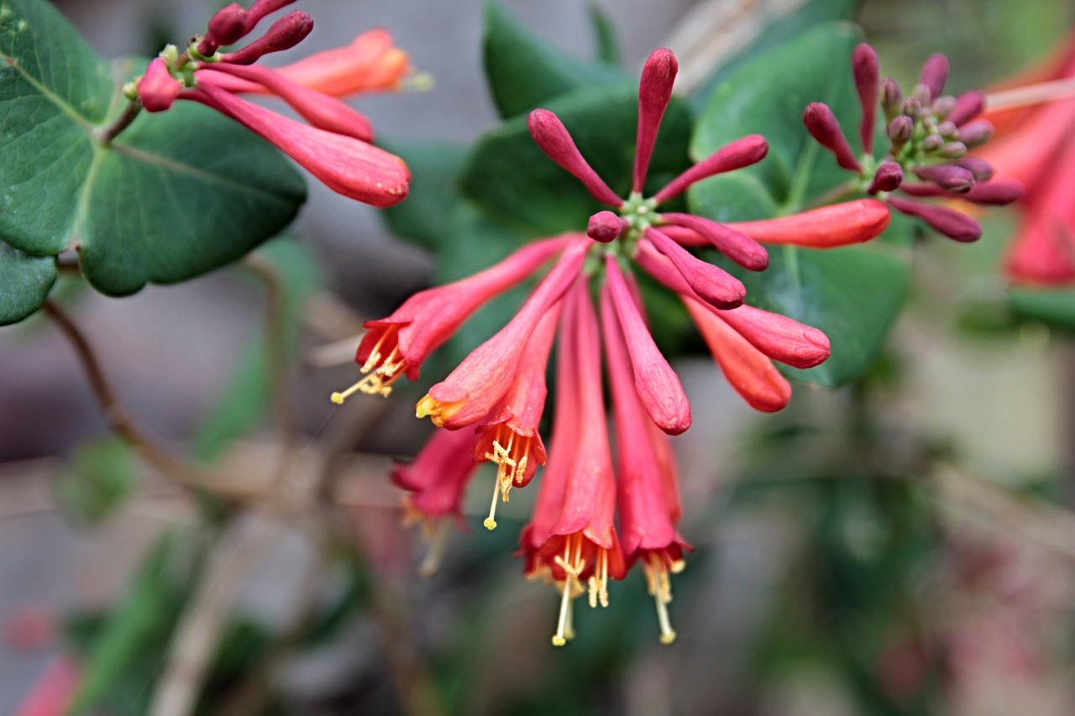


VINES
Black-Eyed Susan Vine Honeysuckle ‘Major Wheeler’ Rambling Rose ‘Open Arms’ Trumpet Vine ‘Apricot’
3-8 feet tall, 3-6 feet wide 6-8 feet tall, 5-10 feet wide 5-8 feet tall, 4-5 feet wide 12-15 feet tall, 3-5 feet wide
Black-Eyed Susan Vine is an annual
Would not recommend any cultivar except ‘Apricot’ for Trumpet Vine; others can grow rampantly
Notes:
Hive shown in upper left has been deserted but shows how the hive is structured about 8 to 10 combs. Oval shaped.
Common for bees in the wild to move into a tree hollow
Honey comb is made of beeswax. Individual cells are hexagon shaped. Cells fit together in a space-saving design.
White substance in cells on lower picture on left side is developing larvae. Eggs develop into larvae, then pupate
A beekeeping hive consists of boxes, each containing 8-10 frames of bees.
Langstroth Hive – Rev. Lorenzo Langstroth 1851
Removable frames revolutionized beekeeping
Bee Space (3/8 inch) keeps bees from cementing the frames together with propolis
Skeps

Slide 23

Happy Planting!

